Slide 1
Part 1: Batching or GPU Sharing?
Tao Li
[1] Faster Transformer. https://github.com/NVIDIA/ FasterTransformer.
[2] Orca: A distributed serving system for Transformer-Based generative models. OSDI’22
[3] vLLM: Efficient memory management for large language model serving with pagedattention. SOSP ’23
[4] Sarathi-Serve: Taming Throughput-Latency Tradeoff in LLM Inference with Sarathi-Serve. OSDI’24
Notes:
1. 我们现在考虑的场景是云上多模型多租户的大模型推理，我们认为GPU sharing是支持这种场景的关键技术，我们之前也讲了一些GPU sharing的技术，因为我们想基于Serverless computing的云环境去做，因此我们最近看了些在容器云上优化GPU sharing的一些工作，今天给两位老师进行一下汇报，结合上次老师们建议我们这次的内容会多一些如何使用GPU等系统实现上的内容。

Slide 2
Batching
FasterTransfomer^{[1]}
vLLM^{[2]}
Orca^{[3]}
Srarathi-Serve^{[4]}
[1] Faster Transformer. https://github.com/NVIDIA/FasterTransformer.
[2] vLLM: Efficient memory management for large language model serving with pagedattention. SOSP ’23
[3] Orca: A distributed serving system for Transformer-Based generative models. OSDI’22
[4] Sarathi-Serve: Taming Throughput-Latency Tradeoff in LLM Inference with Sarathi-Serve. OSDI’24

Slide 3
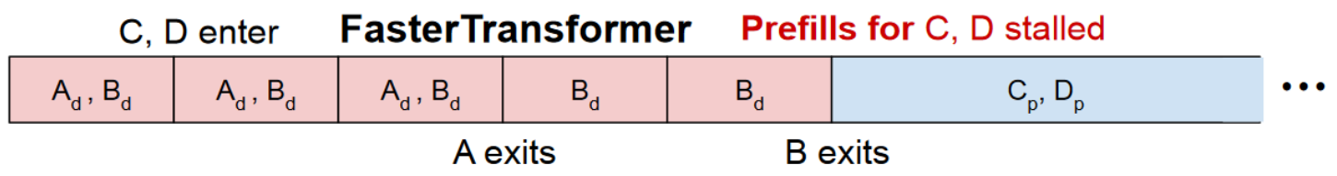
FasterTransfomer
Request-level batching
A new batch runs only after all requests in the current batch completes
Example
Requests C and D enter during the decode phase of requests A and B
Pros and cons
C,D don’t affect the decode of A,B, but prefill for C,D stalled
Timeline
[1] Faster Transformer. https://github.com/NVIDIA/FasterTransformer.

Slide 4
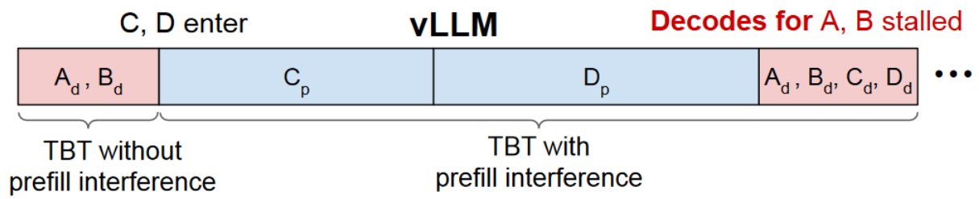
vLLM
Iteration-level and single batching
Requests can dynamically enter or exit a batch at the granularity of individual iterations
Only support batches that contain either all prefill or all decode requests
Pros and cons
Prefill for C and D can be executed immediately
But decodes for A,B stalled
Timeline
[2] vLLM: Efficient memory management for large language model serving with pagedattention. SOSP ’23

Slide 5
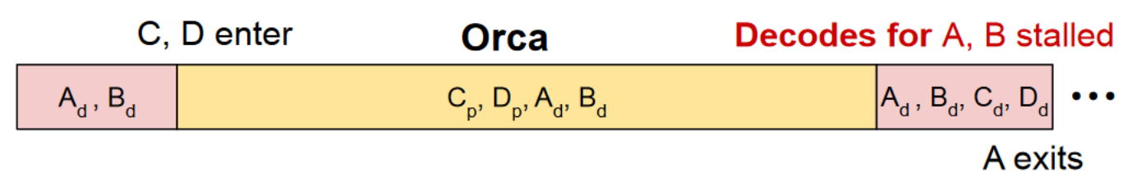
Orca
Iteration-level and hybrid batching
Requests can dynamically enter or exit a batch at the granularity of individual iterations
Support hybrid batches composed of both prefill and decode requests
Pros and cons
Prefill for C and D can be executed immediately
But decodes for A,B still stalled
Timeline
[3] Orca: A distributed serving system for Transformer-Based generative models. OSDI’22

Slide 6
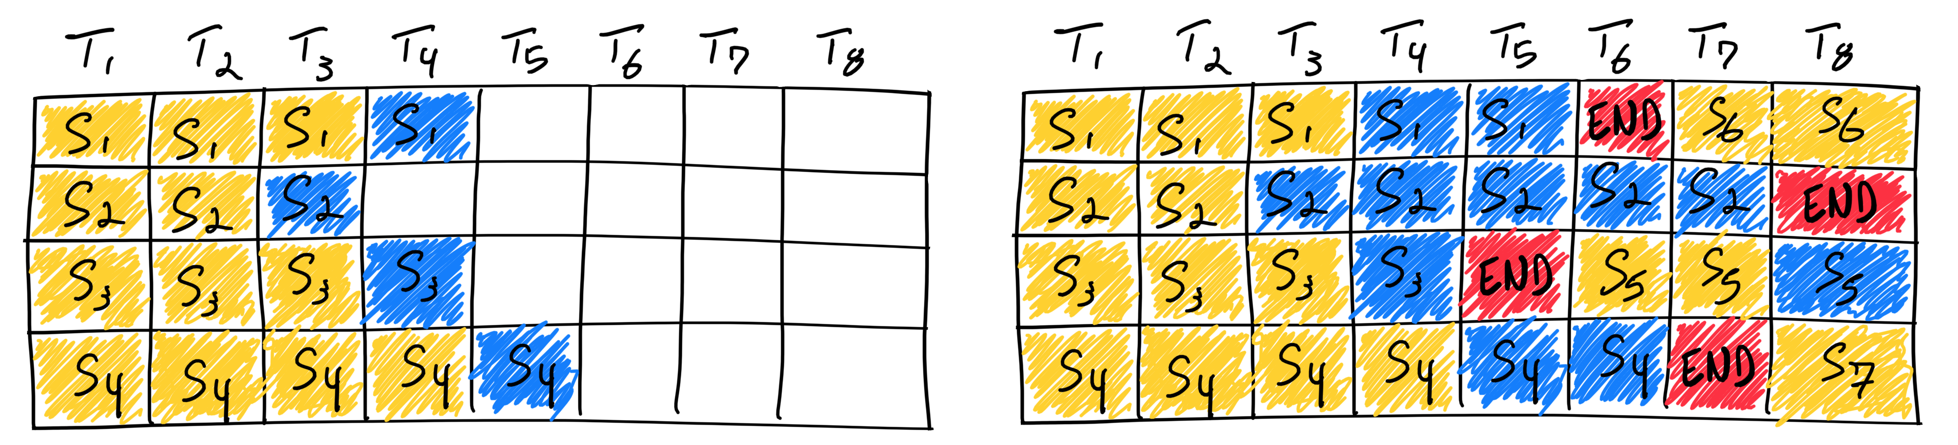
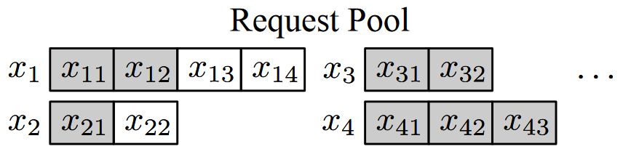
Orca
Hybrid batching
Both requests are in the prefill and each has different number of input tokens (x3 and x4)
Both are in the decode and each is processing a token at different index from each other (x1 and x2)
Each request is in the different phase: prefill or decode (x1 and x3)
[3] Orca: A distributed serving system for Transformer-Based generative models. OSDI’22

Slide 7
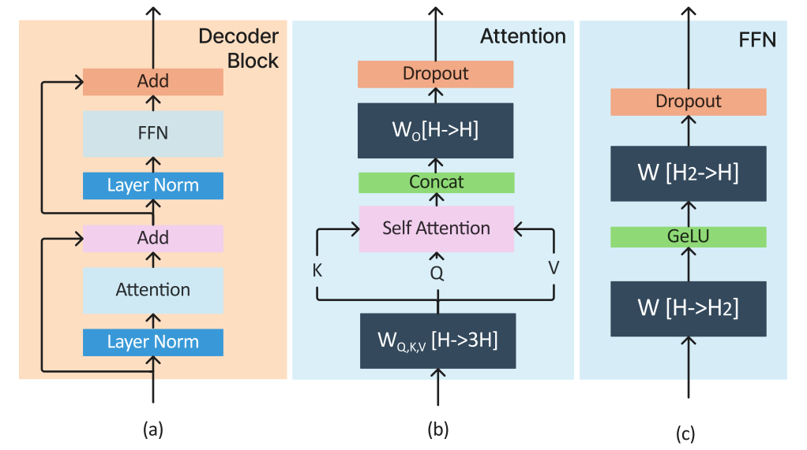
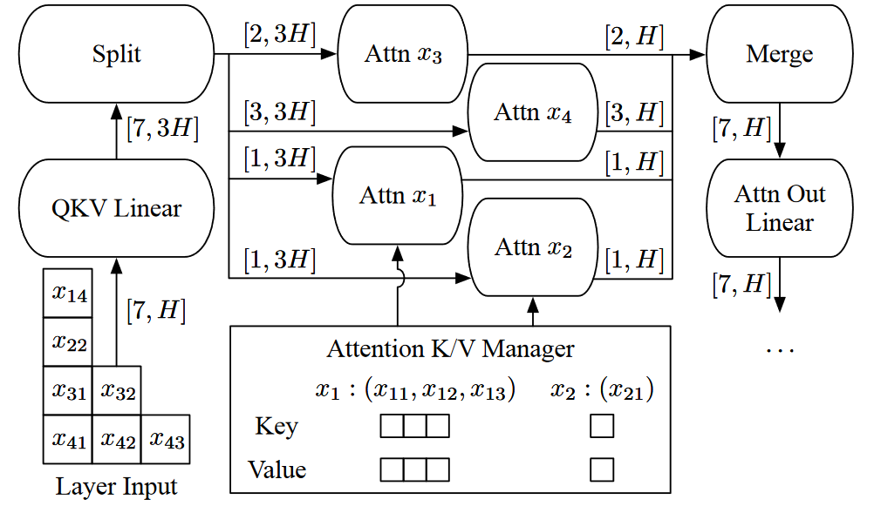
Orca
Hybrid(Selective) batching
A Transformer layer takes a 3D input tensor of shape [B, L, H]
Tensors can be flatten and fed into all non-Attention operations
High-level architecture of a decoder block
An illustration of selective batching
[3] Orca: A distributed serving system for Transformer-Based generative models. OSDI’22

Slide 8
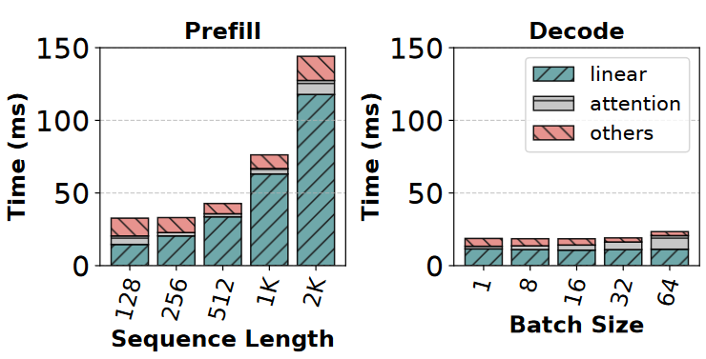
Orca
Hybrid(Selective) batching
A Transformer layer takes a 3D input tensor of shape [B, L, H]
Tensors can be flatten and fed into all non-Attention operations
non-Attention operations contribute more than 80% to the total time
Breakdown of prefill and decode phase
An illustration of selective batching
[3] Orca: A distributed serving system for Transformer-Based generative models. OSDI’22

Slide 9
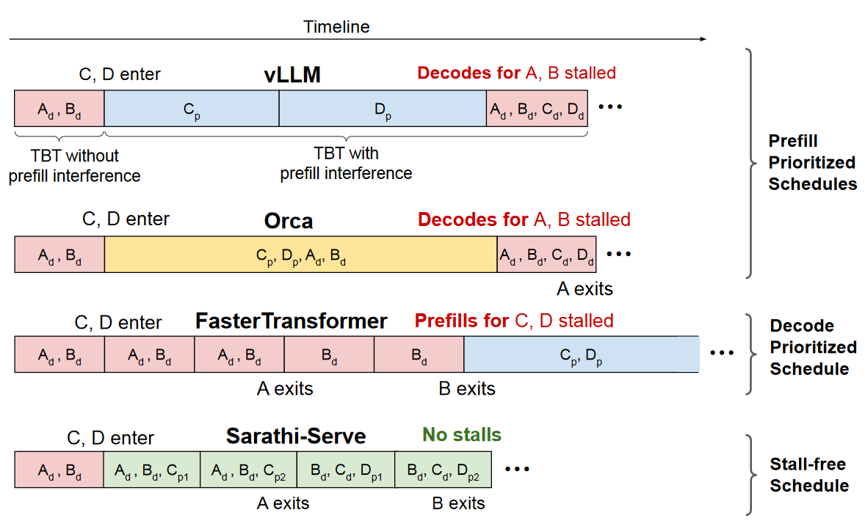
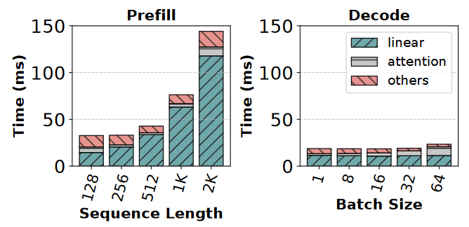
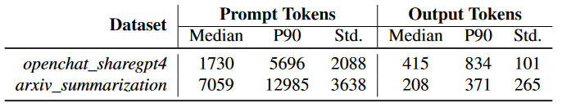
Sarathi-Serve
Chunked-prefills batching
A prefill request with modest sequence length can effectively saturate GPU compute
Input prompts contain several thousand tokens on average
[4] Sarathi-Serve: Taming Throughput-Latency Tradeoff in LLM Inference with Sarathi-Serve. OSDI’24

Slide 10
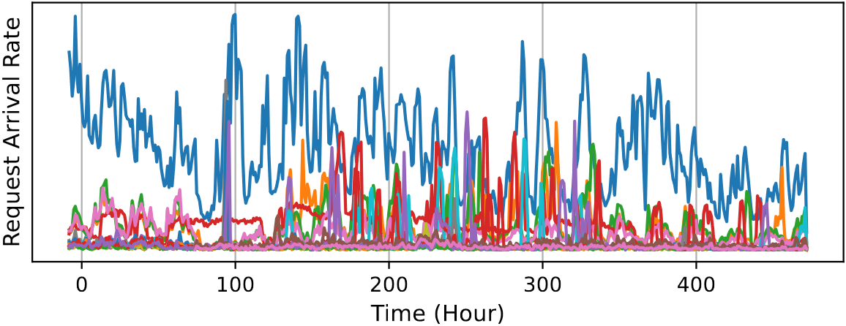
New understanding
Multiple LLMs serving^{[1,2,3,4,5]}
Bursty workloads: real traffic observed by ShangHai AI Lab in 20 days
An example：2 different models deployed on 4 nodes
Bursty Workloads
Low Utilization
Node1
Node3
Node1
Node3
_{Cold Model}
A₁
B₁
Improve
Utilization
A₁
B₁
B₄
A₄
Pipeline
_{Hot Model}
Node2
Node4
Node2
Node4
A₂
B₂
A₂
B₂
B₃
A₃
Deployment 1
Deployment 2
[1] MuxServe: Flexible Spatial-Temporal Multiplexing for Multiple LLM Serving. ICML’24
[2] ServerlessLLM: Low-Latency Serverless Inference for Large Language Models. OSDI’24
[3] dLoRA: Dynamically Orchestrating Requests and Adapters for LoRA LLM Serving. OSDI’24
[4] AlpaServe: Statistical Multiplexing with Model Parallelism for Deep Learning Serving. OSDI’23
[5] PetS: A unified framework for Parameter-Efficient transformers serving. ATC’22
Notes:
TODO: multi-tenant与multi-model的区别？

Slide 11
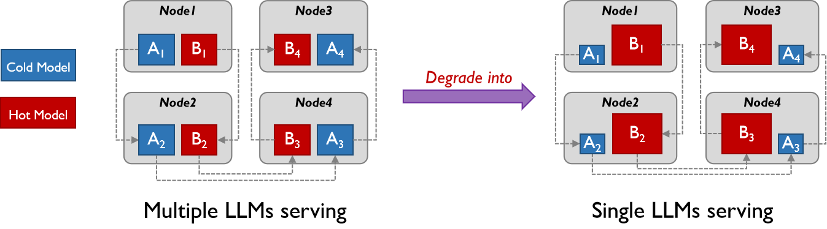
New understanding
Multiple LLMs serving v.s Single LLM serving
When the load of one model becomes dominant, the multiple models effectively behave as a single model
Notes:
TODO: multi-tenant与multi-model的区别？

Slide 12
New understanding
Multiple LLMs serving v.s Single LLM serving
When the load of one model becomes dominant, the multiple models effectively behave as a single model
Node1
Node3
Node1
Node3
A₁
B₁
B₄
A₄
B₁
B₄
_{Cold Model}
A₁
A₄
Degrade into
_{Hot Model}
Node2
Node4
Node2
Node4
A₂
B₂
B₃
A₃
B₂
B₃
A₂
A₃
Multiple LLMs serving
Single LLMs serving
Notes:
TODO: multi-tenant与multi-model的区别？

Slide 13
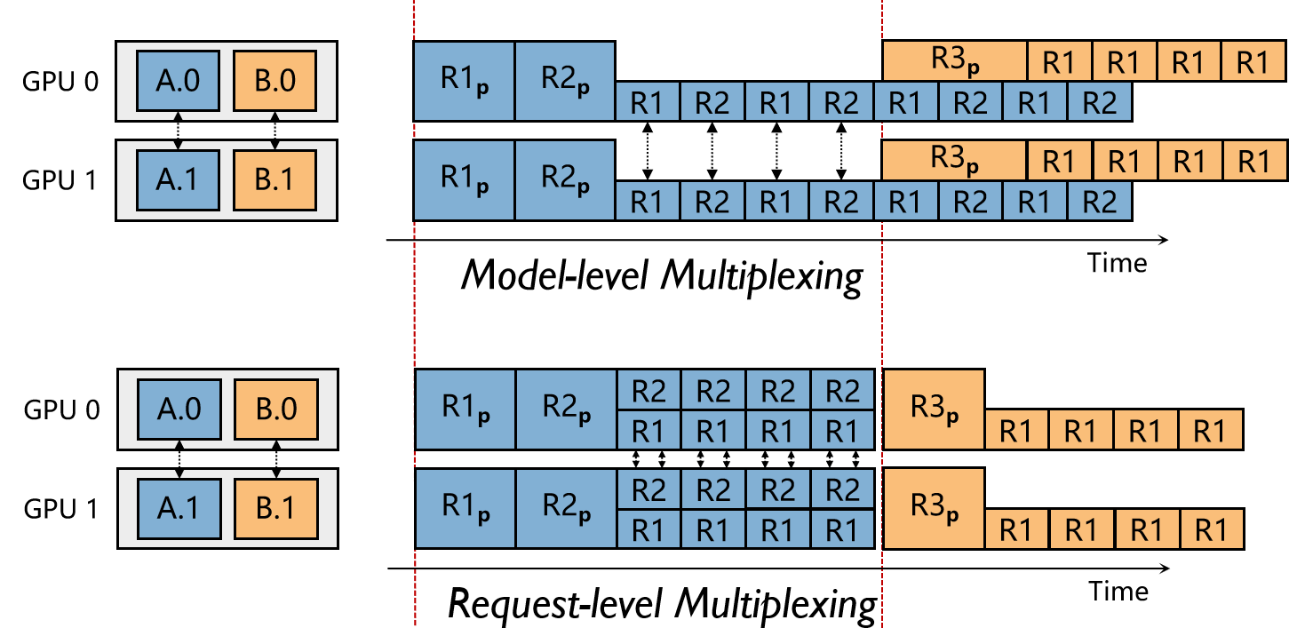
Multi-level Multiplexing
Model-level
Temporal sharing
Spatial sharing
Request-level
Batching
Temporal sharing
Spatial sharing
Notes:
TODO: multi-tenant与multi-model的区别？

Slide 14
Part 2: M-LoRA
Tao Li

Slide 15
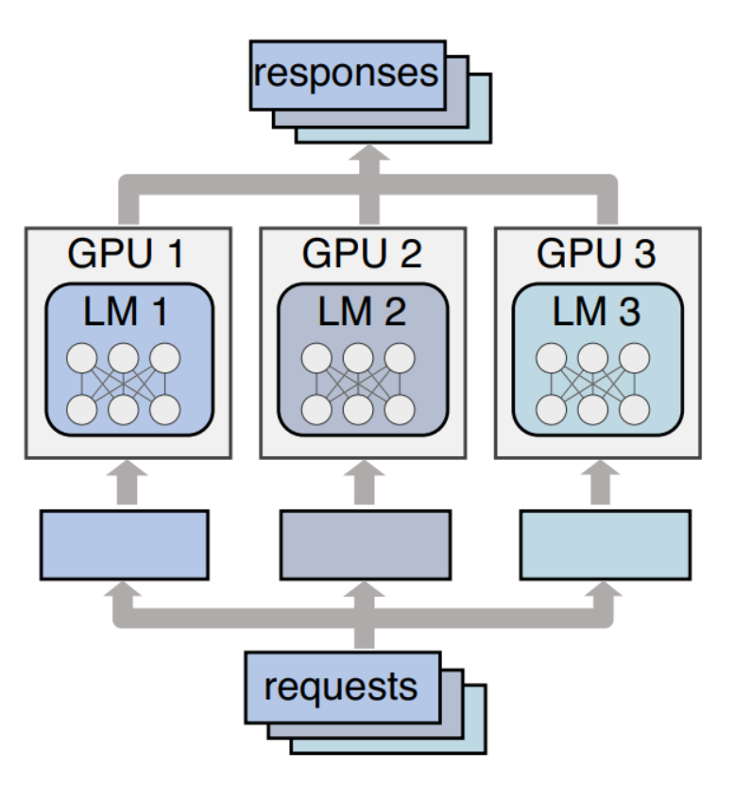
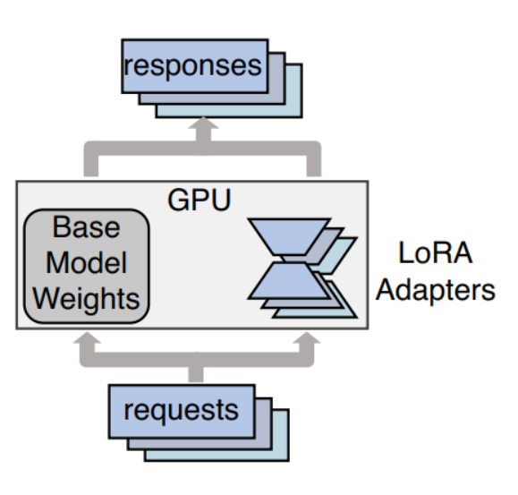
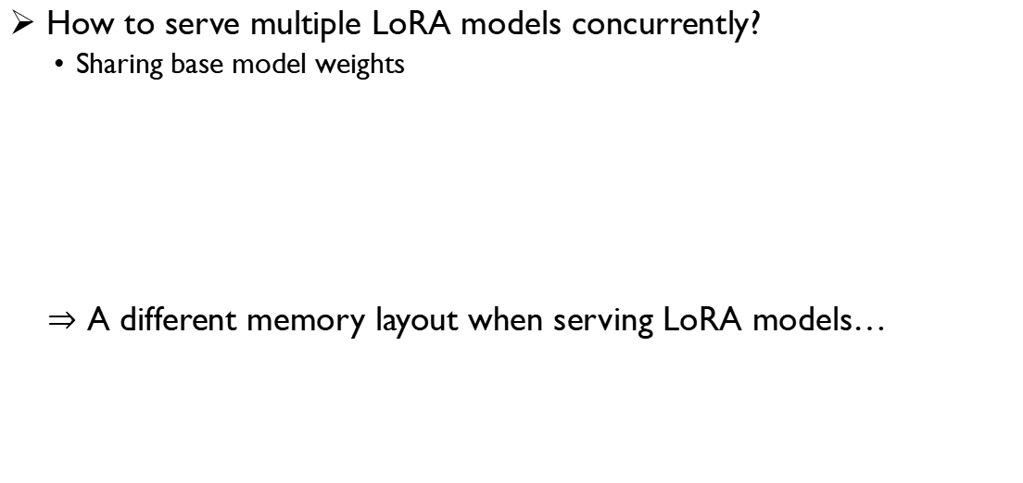
Introduction
How to serve multiple LoRA models concurrently?
Sharing base model weights
$⇒$ A different memory layout when serving LoRA models…
HBM
Base model weights
LoRA adapters
KV cache
Other tensors
Notes:
当前最先进的lora serving技术是，对于从同一预训练模型fine-tune得到的adapters，在推理时共享预训练模型权重，而对不同的adapter请求分别计算，以节省显存资源和调度开销。

Slide 16
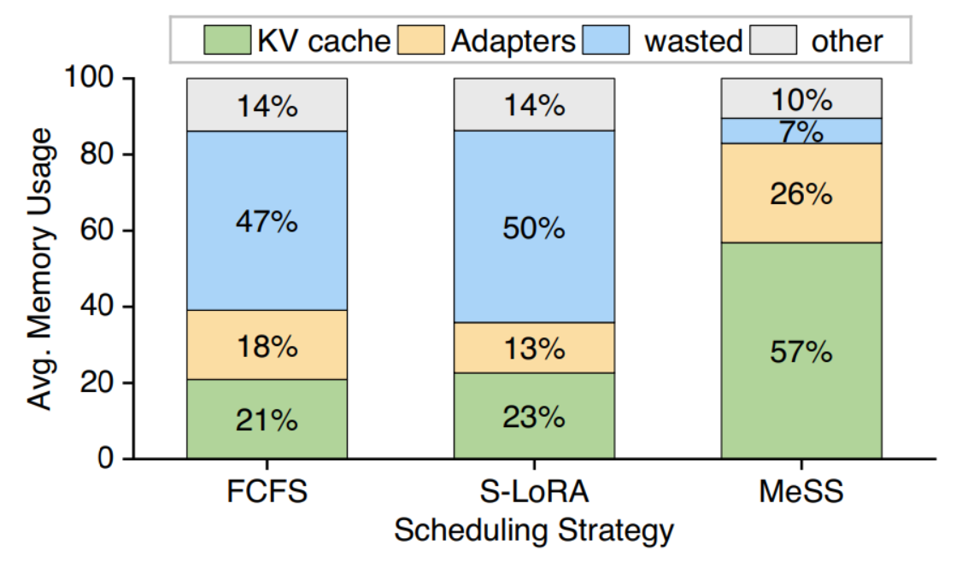

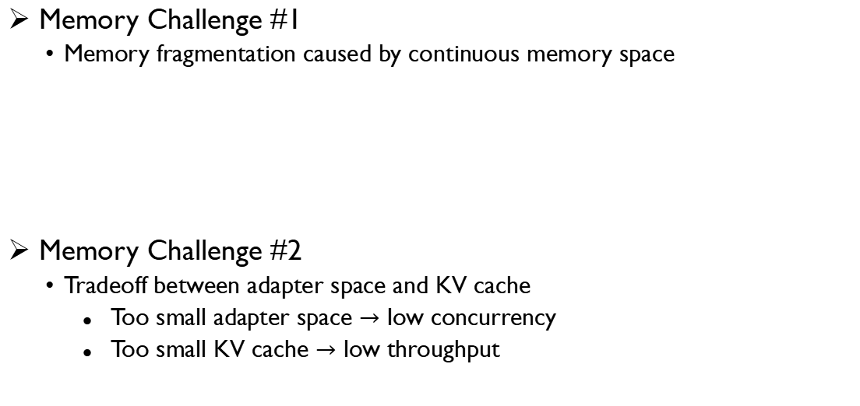
Introduction
Memory Challenge #1
Memory fragmentation caused by continuous memory space
Memory Challenge #2
Tradeoff between adapter space and KV cache
Too small adapter space $→$ low concurrency
Too small KV cache $→$ low throughput

Slide 17
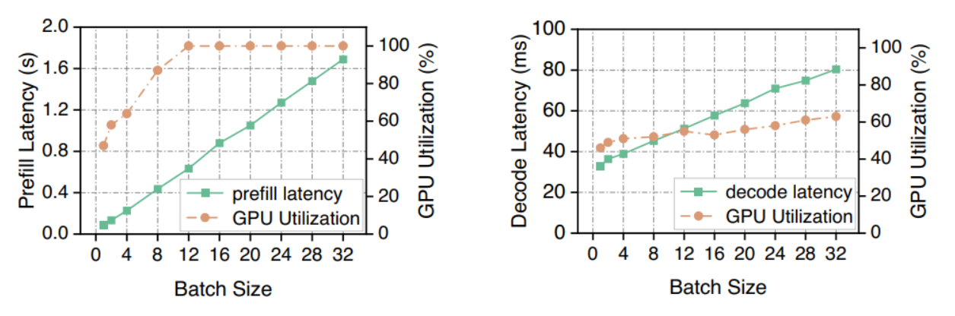
Background
Chance: Improving batch size can improve GPU utilization
In prefill phase, GPU can easily be fully utilized, leading to propotional latency
In decode phase, GPU is under-utilized (memory-bound)
Increasing the batch size can improve GPU util.% with minimally increasing latency

Slide 18
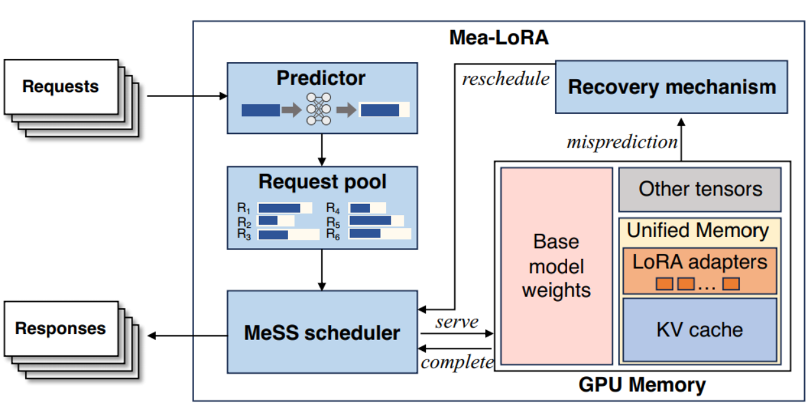
Goal
Optimizing memory utilization in LoRA serving to maximize batch
1. Get request output length in advance (predicting)
2. Schedule requests to maximize batch sizes while meet GPU memory limits
3. Recover under-misprediction
Notes:
在推理之前预测请求的推理长度
对请求进行schedule，以使得下一个batch的size最大，同时满足GPU memory的限制（这里基于第1步中的请求预测长度来计算kvcache占据的空间）
在预测出错（过短）的时候完成错误修复，将其驱逐出GPU，放入scheduler中重新规划batch。

Slide 19
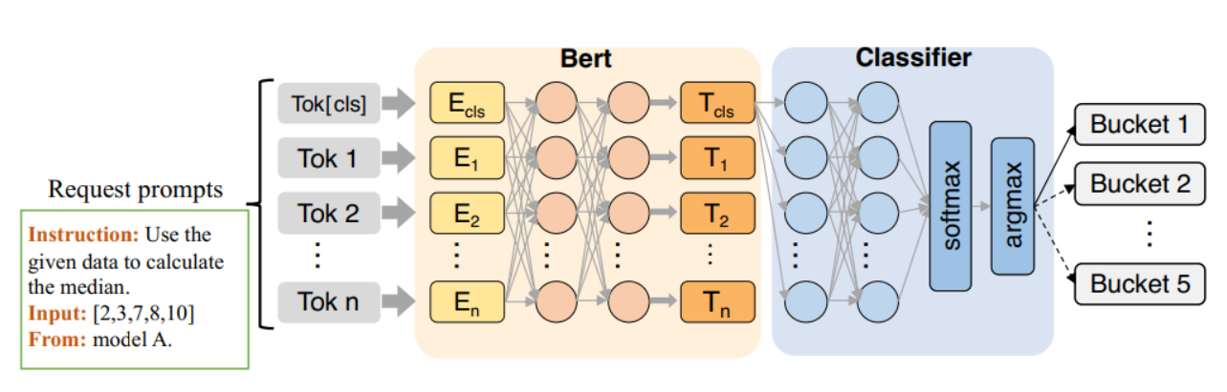
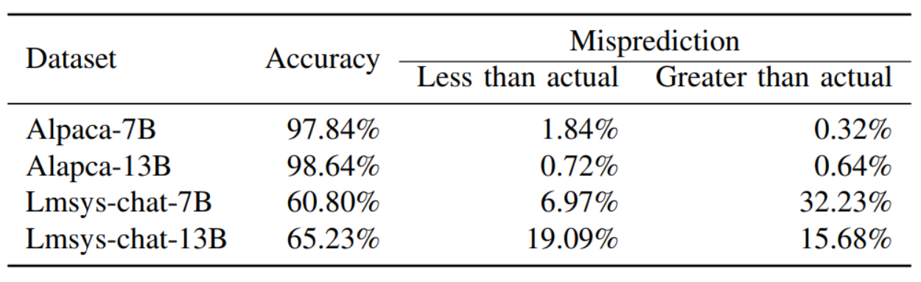
Design
Output length predictor
Predict output lengths based on input sequences
Use BERT-110M as base of the predictor and classify inputs

Slide 20
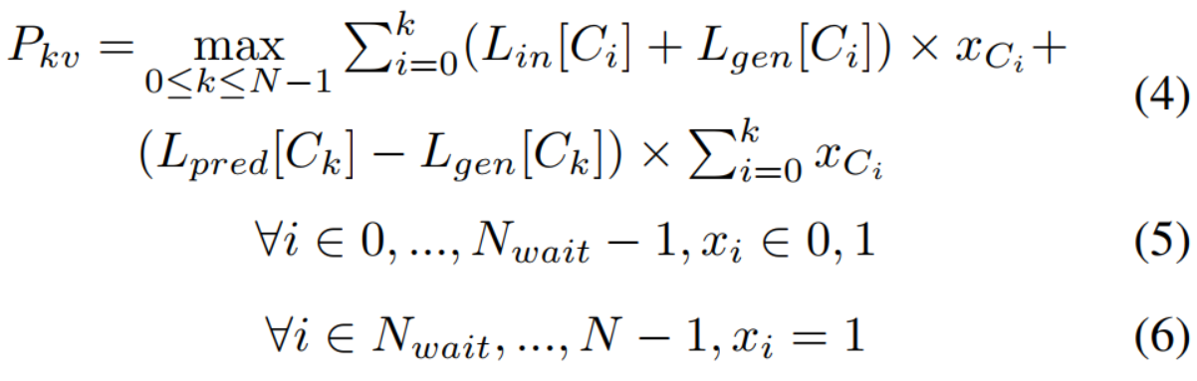
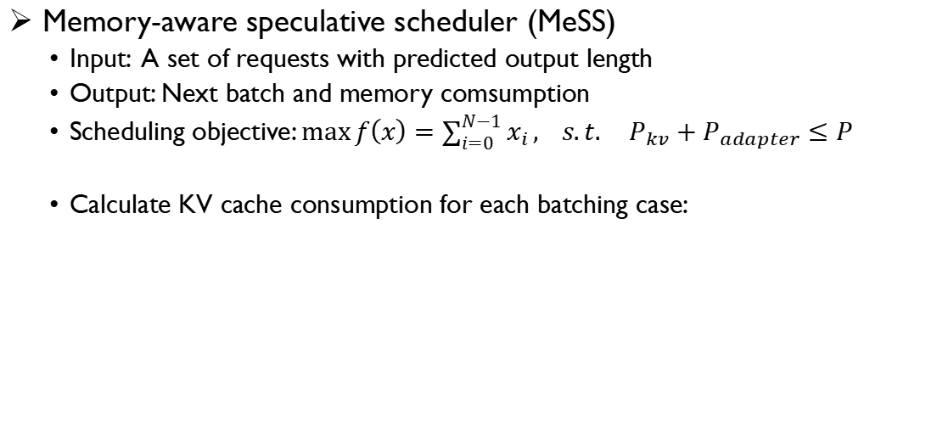
Design
Memory-aware speculative scheduler (MeSS)
Input: A set of requests with predicted output length
Output: Next batch and memory comsumption
Scheduling objective: $\max{f\left(x\right)=\sum_{i=0}^{N−1}{x_{i}}}, s.t. P_{kv}+P_{adapter}≤P$
Calculate KV cache consumption for each batching case:
1
1
1
1
1
1
2
2
2
2
2
2
…
3
3
3
3
3
3
!
4
4
4
!
max
Notes:
对于每一种batch的可能性，计算KV cache的过程如右下图所示，计算adapter内存消耗的过程就是将上一步中每个请求到的adapter大小求和。这一个design的建模和算法部分非常详尽、标准。

Slide 21
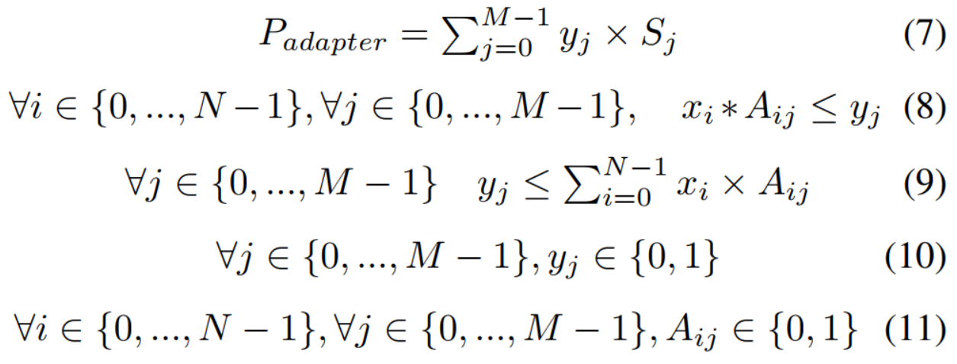
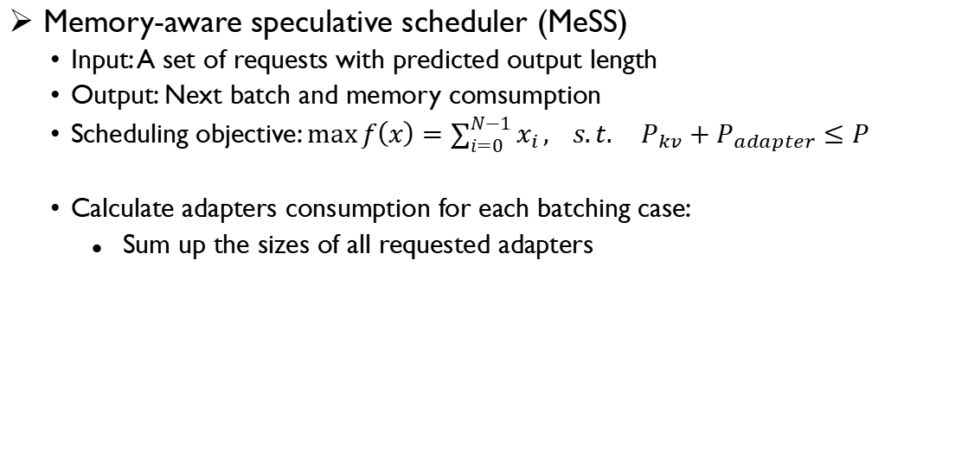
Design
Memory-aware speculative scheduler (MeSS)
Input: A set of requests with predicted output length
Output: Next batch and memory comsumption
Scheduling objective: $\max{f\left(x\right)=\sum_{i=0}^{N−1}{x_{i}}}, s.t. P_{kv}+P_{adapter}≤P$
Calculate adapters consumption for each batching case:
Sum up the sizes of all requested adapters
Notes:
对于每一种batch的可能性，计算KV cache的过程如右下图所示，计算adapter内存消耗的过程就是将上一步中每个请求到的adapter大小求和。这一个design的建模和算法部分非常详尽、标准。

Slide 22
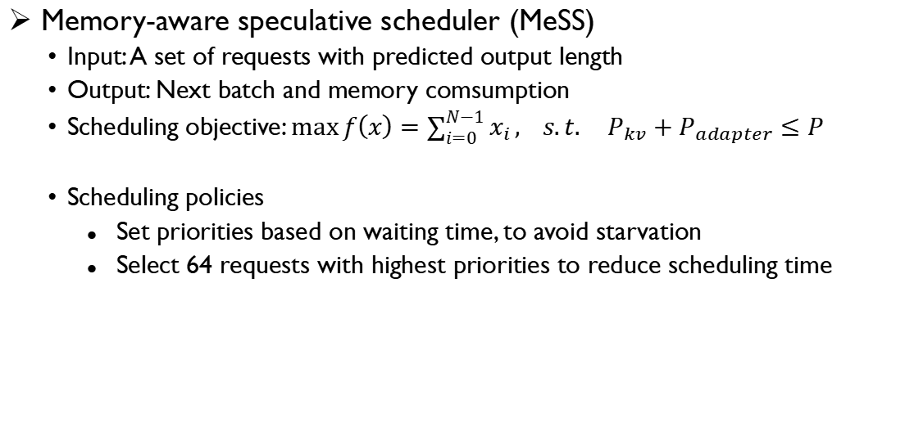
Design
Memory-aware speculative scheduler (MeSS)
Input: A set of requests with predicted output length
Output: Next batch and memory comsumption
Scheduling objective: $\max{f\left(x\right)=\sum_{i=0}^{N−1}{x_{i}}}, s.t. P_{kv}+P_{adapter}≤P$
Scheduling policies
Set priorities based on waiting time, to avoid starvation
Select 64 requests with highest priorities to reduce scheduling time
Notes:
对于每一种batch的可能性，计算KV cache的过程如右下图所示，计算adapter内存消耗的过程就是将上一步中每个请求到的adapter大小求和。这一个design的建模和算法部分非常详尽、标准。

Slide 23
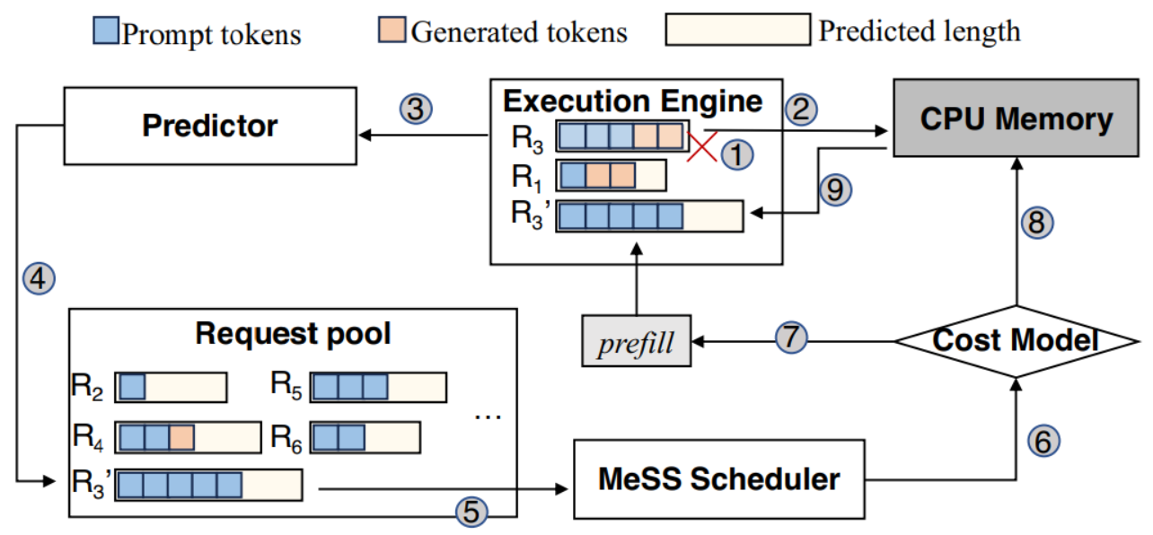
Design
Recovery Mechanism
Remove and recover length-under-estimated requests
Select recovery mechanism with lower cost
Recomputation
CPU-offload
CPU-offload
Recomputation
Notes:
这里介绍两种恢复机制，重计算使用计算资源较多，而CPU-offload使用存储和带宽资源较多，系统可以动态地选择当前开销影响较小的方式。
对这里的疑问：重新进入scheduling阶段就能避免下一次scheduling依然发生过短预测吗？文中并没有提到这一点。

Slide 24
Merits
Good observation on adapters v.s. KV cache
The predict-schedule idea is complete
Formulation and modeling in scheduler design is fit and proper

Slide 25
Weaknesses
Lack of peer comparison
Doesn’t illustrate the designing difference between M-LoRA and S-LoRA (SOTA)
Ignores current dynamic memory management (e.g., vLLM) in motivation, undermining the credibility of the focus
Lack of reliability and analysis for evaluation
Doesn’t tell clearly why the design/idea leads to better performance, since we already have paged memory in S-LoRA

Slide 26
Part 3: GPU服务器采购
Tao Li, Zhuoyuan Li, Chuanyi Liu
Notes:
1. 我们现在考虑的场景是云上多模型多租户的大模型推理，我们认为GPU sharing是支持这种场景的关键技术，我们之前也讲了一些GPU sharing的技术，因为我们想基于Serverless computing的云环境去做，因此我们最近看了些在容器云上优化GPU sharing的一些工作，今天给两位老师进行一下汇报，结合上次老师们建议我们这次的内容会多一些如何使用GPU等系统实现上的内容。

Slide 27
服务器配置
GPU服务器型号：Inspur NF5468M6-P
CPU：2颗Intel至强金牌6330 56核 2.0GHz
GPU：2颗 Nvidia Tesla A40（单颗￥45000）
NVLink桥接器：1个
内存：256GB（→512GB）
电源：4颗2200W 80plus 铂金牌PSU
Nvme SSD：2*960GB
硬盘：3*16TB（→16TB）
网卡：1块双口万兆网卡
价格：￥179600

Slide 28
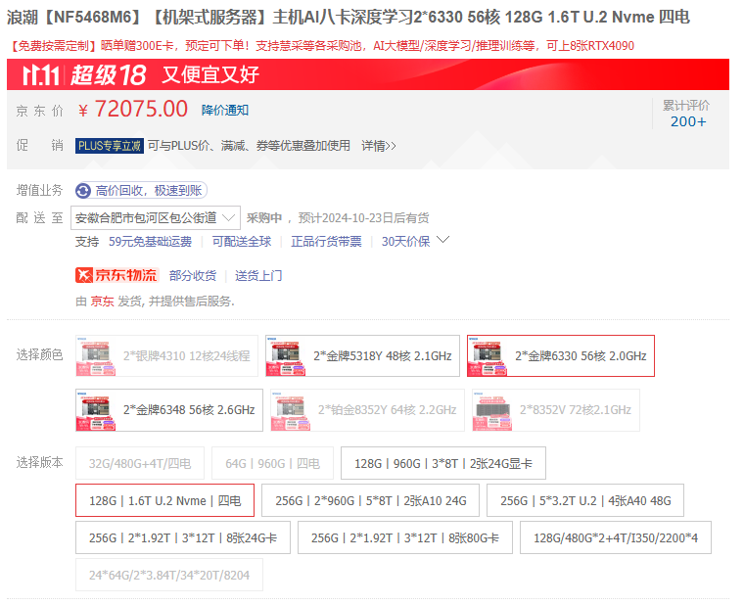
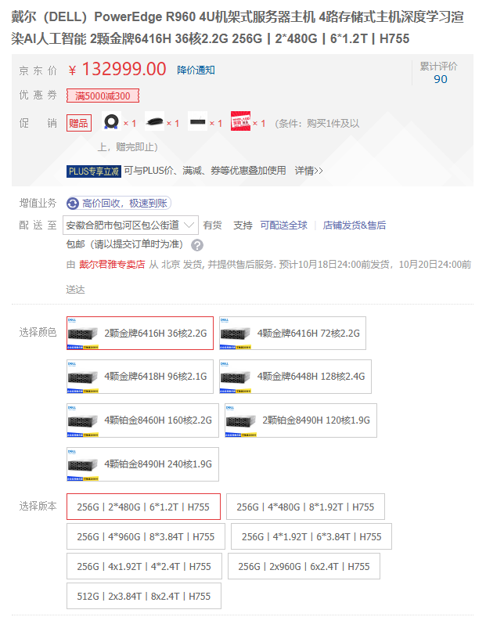
服务器选择
浪潮NF5468M6-P
DELL R960

Slide 29
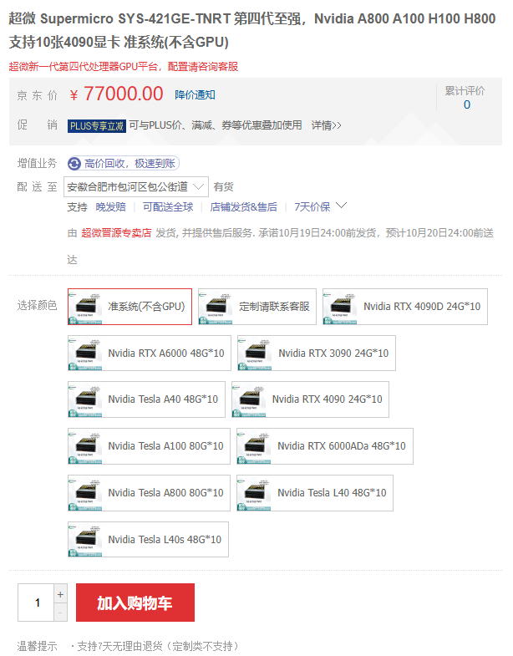
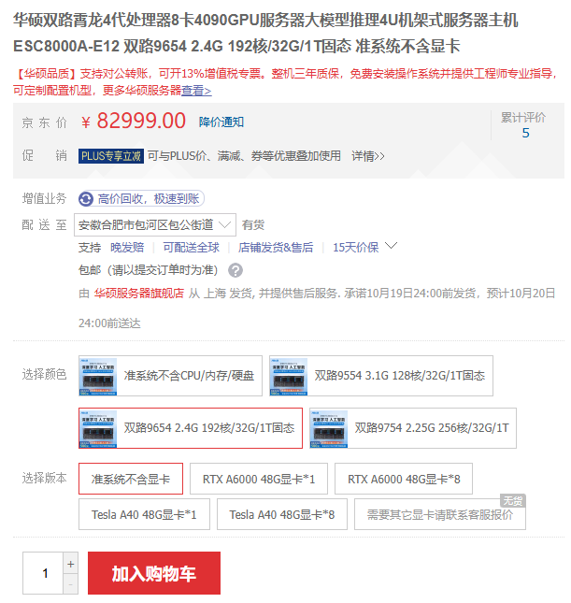
服务器选择
超微SYS-421GE
华硕ESC8000A-E12

Slide 30
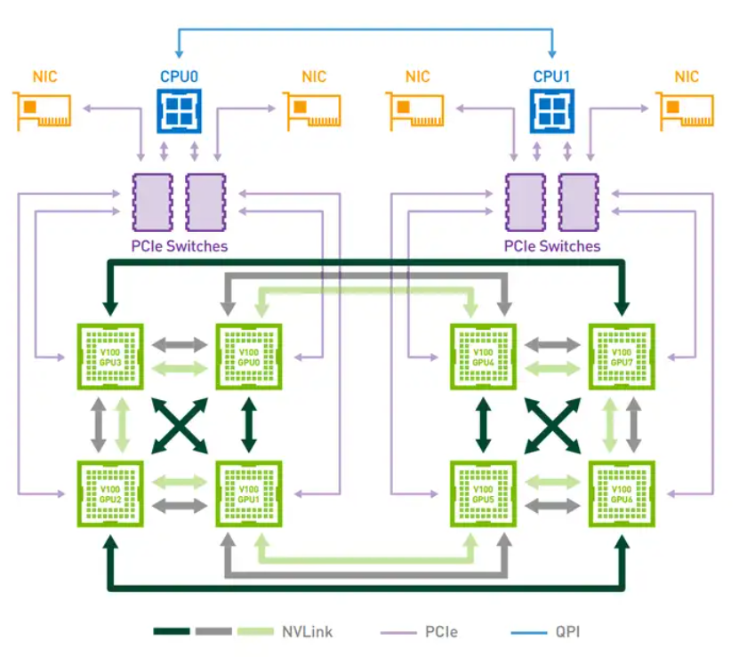
GPU互连架构
NVLink
Bandwidth up to 112.5 GB/s (PCIe: 64GB/s)
Only one-to-one connection with a NVLink bridge
Needs amounts of bridges to build a super cube
NVLink bridge
CPU
NIC
GPU #1
GPU #2
PCIe

Slide 31

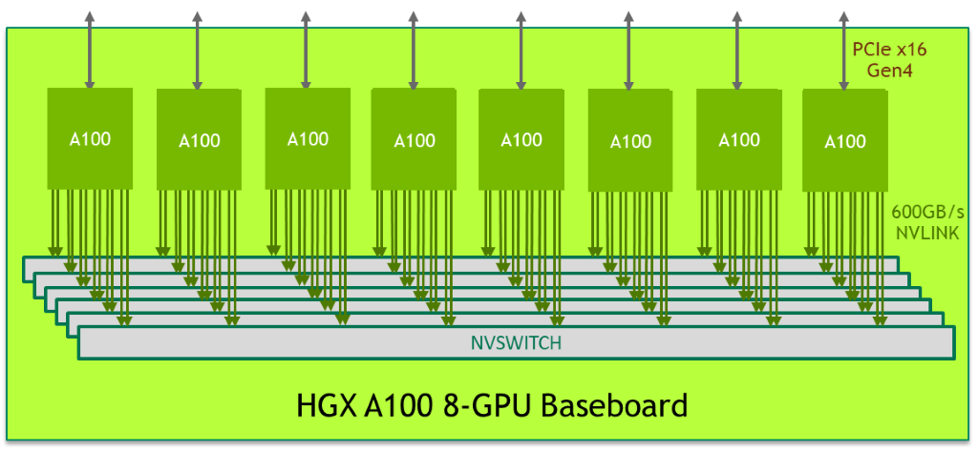
GPU互连架构
NVSwitch
Provide all-to-all GPU communication (system upper bound: 900 GB/s)
Specific hardware: DGX/HGX platform + V/P/A/H 100 GPU
NVSwitch chip
HGX mainboard

Slide 32
面向服务器无感计算的多实例大模型推理吞吐量优化 Optimizing Throughput-oriented Serverless Inference for Multiple LLMs Serving
Chuanyi Liu

Slide 33
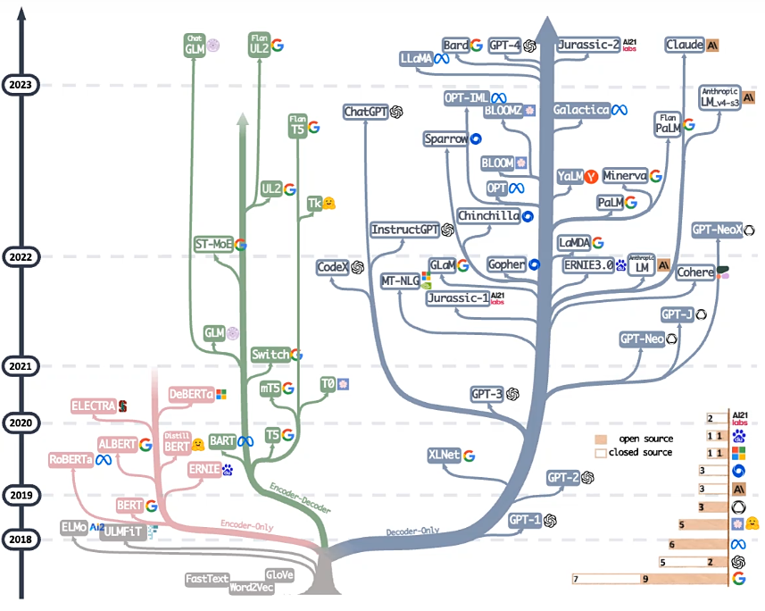
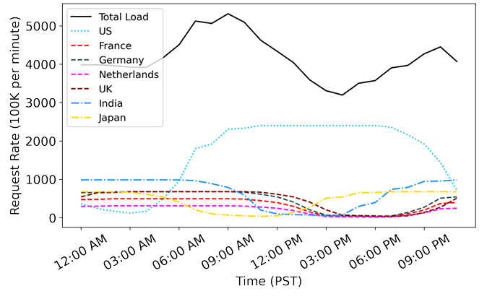
Motivation
LLMs are developing rapidly and becoming increasingly important
Improving LLM throughput is crucial^{[1]}
Evolutionary trees for large language models
Future LLM serving load based on Google visits
[1] Reducing the Carbon Impact of Generative AI Inference (today and in 2035)

Slide 34
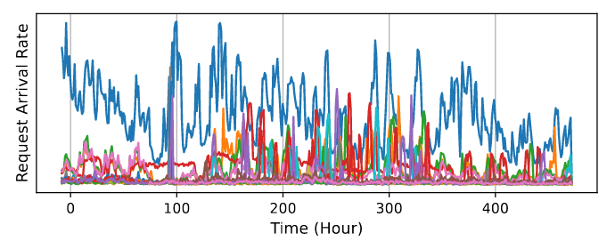
Motivation
Multiple LLMs Serving^{[1]}
Different LLMs have varying levels of popularity, with burst workload concurrently
Existing systems allocate separate groups of GPUs for each LLM
leading to waste of GPU resources
Colocating multiple LLMs to multiplex GPU resources can enhance utilization
[1] MuxServe: Flexible Spatial-Temporal Multiplexing for Multiple LLM Serving. ICML’24

Slide 35
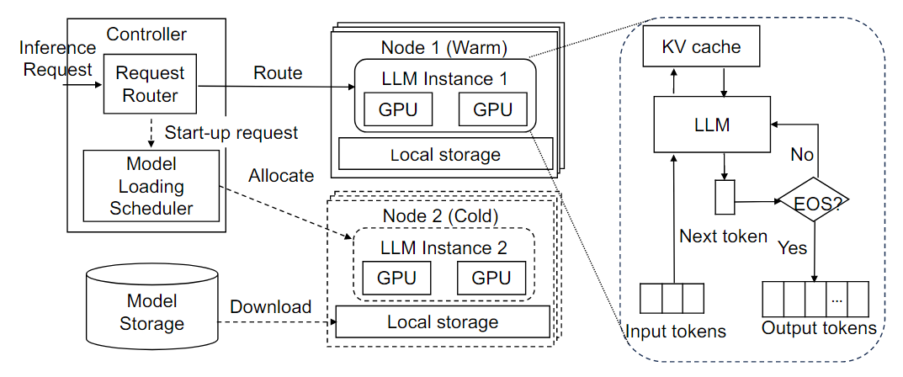
Motivation
Multiple LLMs Serving^{[1]}
Serverless computing is suitable for this scenario
Easy to use
Automatic scaling
Fine-grained billing
Serverless inference paradigm^{[2]}
Controller: request scheduling
Worker node: Executing inference
[1] MuxServe: Flexible Spatial-Temporal Multiplexing for Multiple LLM Serving. ICML’24
[2] ServerlessLLM: Low-Latency Serverless Inference for Large Language Models. OSDI’24

Slide 36
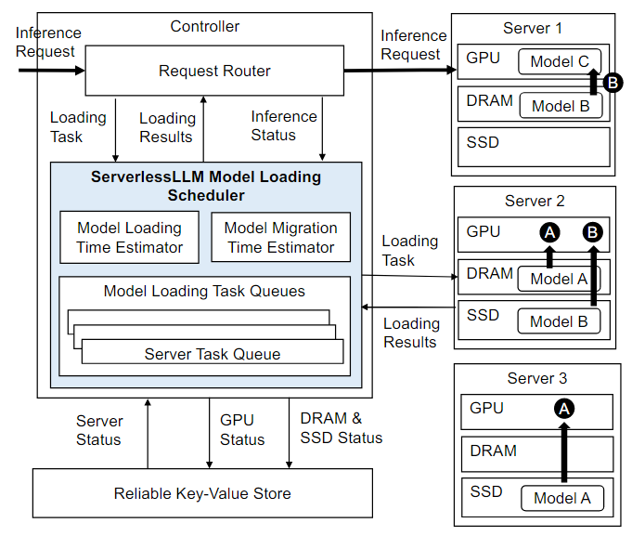
Motivation
Current challenges of serverless inference
Downloading and loading LLMs causes high latency
LLM serving needs to meet SLO requirements
ServerlessLLM^{[1]}
mitigate inference delays
Utilize multi-tier storage to accelerate model loading
Live migration for LLM inference
[1] ServerlessLLM: Low-Latency Serverless Inference for Large Language Models. OSDI’24

Slide 37
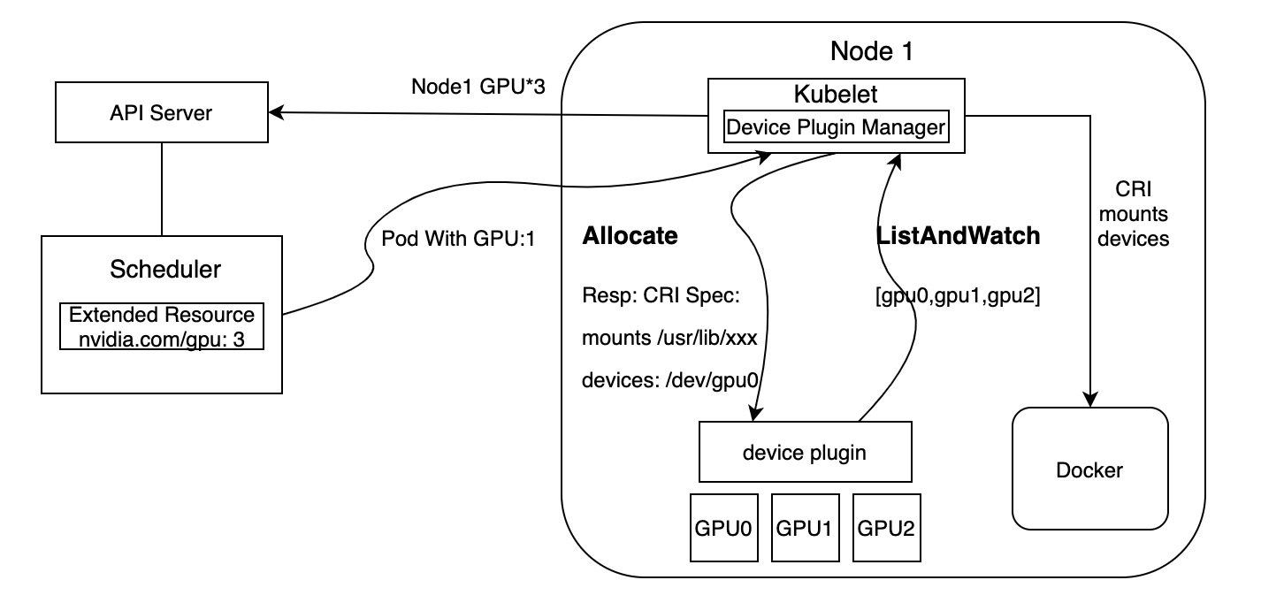
Design
How to further improve LLM inference throughput?
GPU sharing
Timeslicing
Multi-Instance GPU (MIG)
Multi-Process Service (MPS)
Device plugin

